Slide 1
RISC-V Control Flow, Bitwise Ops
Slides: PDF

Slide 2
HLL vs. Assembly: Data representation
C, Java
RISC-V
In high-level languages, variable types determine operation.
In assembly language, the registers have no type.
Register contents are just bits.
Operation determines “type,” i.e., how register contents are treated.
as value, memory address, etc.
uint8_t x, *y;
…
x = *y;
lb x1 0(x3)
# versus
lbu x1 0(x3)
Given the RISC-V instruction ops, you can (usually) infer what the analogous C code is.

Slide 3
Bitwise Operations

Slide 4
Bitwise Operations
Bitwise AND, OR, XOR, and NOT
Perform the operation on the binary one bit at a time
 | Example | RISC-V: Register
AND | 0b1001 & 0b0111 = 0b0001 | and rd rs1 rs2
OR | 0b1001 | 0b0111 = 0b1111 | or rd rs1 rs2
XOR | 0b1001 ^ 0b0111 = 0b1110 | xor rd rs1 rs2
NOT | ~0b1001 = 0b0110 | not rd rs1 (pseudo)
Left and Right Shift
Shift the bits of the number left/right, then fill the remaining bits
Shift left | 0b0001 << 3 = 0b1000 = 8 | sll rd rs1 rs2
Shift right | 0b1001 >> 2 = 0b0010 = 2 | srl rd rs1 rs2 sra rd rs1 rs2
Why…?

Slide 5
Shift Left Logical (sll)
Left shift by n
Multiply by 2^{n}
Bit shifts have mathematical equivalents.
In hardware, we must consider the resulting 32-bit word.
Bit shifts create new bits. Should those bits be filled with 0 or 1?
1 << 3 = 8
0b 0000 … 0000 0001
1
0b 0000 … 0000 0001
0b 0000 … 0000 1000
8
(3 bits shift out)
3 new bits, fill 0
000
Logical left shift
(sll, add zeros)

Slide 6
Right Shift: Logical vs. Arithmetic
Left shift by n
Multiply by 2^{n}
Right shift by n
(Floor) Divide by 2^{n}
9 >> 2
= floor(2.25) = 2
-9 >> 2
= floor(-2.25) = -3
1 << 3 = 8
1
9
9
-9
0b 0000 … 0000 0001
0b 0000 … 0000 1001
-9
0b 0000 … 0000 1001
0b 1111 … 1111 0111
0b 1111 … 1111 0111
0b 0000 … 0000 1000
8
0b 0000 … 0000 0010
2
0b 1111 … 1111 1101
-3
3 new bits, fill 0
2 new bits, fill 0
(2 bits shift out)
2 new bits, fill 1
(2 bits shift out)
Logical left shift
(sll, add zeros)
Logical right shift
(srl, zero-extend)
Arithmetic right shift
(sra, sign-extend)
In RISC-V, operations determine “type,” i.e., how register contents are treated. Shift logical: ignore sign, shift arithmetic: signed

Slide 7
Arithmetic Immediate Instructions
Each arithmetic instruction has two variants:
“Register” (two source register operands)
“Immediate” (one source register operand)
Bitwise immediate instructions are useful for bitmasks:
andi with 0x000000FF isolates least significant byte
andi with 0xFF000000 isolates most significant byte
 | RISC-V: Register | RISC-V: Immediate
AND | and rd rs1 rs2 | andi rd rs1 imm
OR | or rd rs1 rs2 | ori rd rs1 imm
XOR | xor rd rs1 rs2 | xori rd rs1 imm
NOT | not rd rs1 (pseudo)
Shift left | sll rd rs1 rs2 | slli rd rs1 imm
Shift right | srl rd rs1 rs2 sra rd rs1 rs2 | srli rd rs1 imm srai rd rs1 imm

Slide 8
Arithmetic Operations NOT in RISC-V
Bitwise NOT: a pseudoinstruction.
not rd rs1 → xori rd,rs1,-1
0b 1111 … 1111 0111
rs1
0b 1111 … 1111 1111
-1
0b 0000 … 0000 1000
rd
Other common RISC-V extensions that are not in base RISC-V:
General multiplication
Circuit is significantly more complicated than bitwise operation!
Same for division, mod
Float addition, subtraction, etc.
Much more complicated circuitry!
We won’t discuss these.

Slide 9
What is in x12?
1
2
3
4
li x10 0x34FF
slli x12 x10 0x10
srli x12 x12 0x08
and x12 x12 x10
Hint: Bitmasking.
Earlier example: andi with 0x000000FF isolates least significant byte.
A. 0x0
B. 0x3400
C. 0x4F0
D. 0xFF00
E. 0x34FF
F. Something else

Slide 10
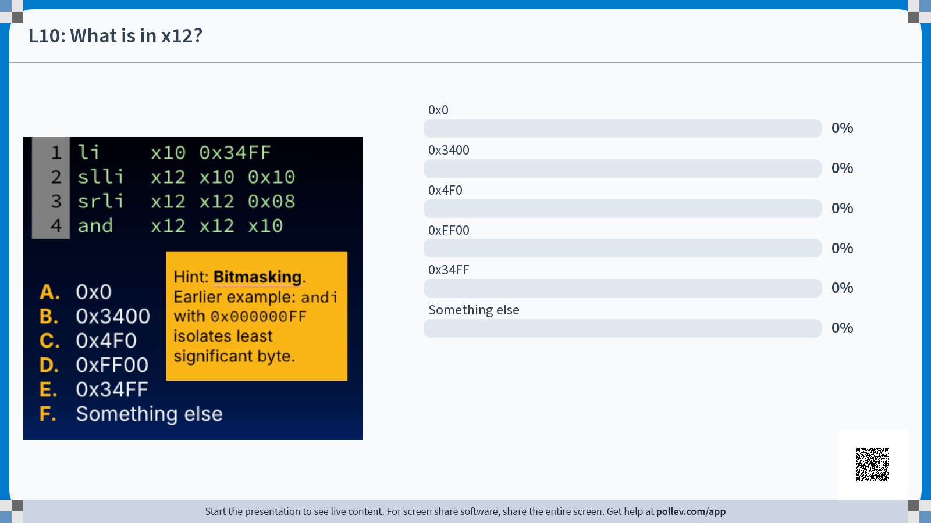

Slide 11
What is in x12?
B. 0x3400
1
2
3
4
li x10 0x34FF
slli x12 x10 0x10
srli x12 x12 0x08
and x12 x12 x10
4
0x0000 34FF
& 0x0034 FF00
0x0000 3400
1
x10
0x0000 34FF
0x34 0b0011 1000
& 0xFF 0b1111 1111
0b0011 1000
x12
0xABCD ABCD
2
x10
0x0000 34FF
x12
0x34FF 0000
x10
0x0000 34FF
3
x10
0x0000 34FF
x12
0x0000 3400
x12
0x0034 FF00

Slide 12
From last time: Question 1
For a written walkthrough, check Ed (#173bf).
int a = 5;
char b[] = "string";
int c[10];
uint8_t d = b[3];
c[4] = a+d;
c[a] = 20;
13
14
15
16
17
18
li t0 20
lw t1 0(sp)
slli t1 t1 2
addi t1 t1 12
add t1 t1 sp
sw t0 0(t1)
L13-L18 is a translation of the C statement c[a] = 20;
Assume before L13:
sp: stack pointer register
a is stored at 0(sp)
c is stored at 12(sp)
1. At L18, what C expression is the closest representation of the value stored in t1?
2. Why might a compiler NOT translate this C statement to the RV32I instruction sw t0 20(sp)?
A. &c
B. &a
C. c[20]
D. c[a]
E. &c[a]
F. Something else
[skipped in live lecture]

Slide 13
From last time: Question 1
For a written walkthrough, check Ed (#173bf).
int a = 5;
char b[] = "string";
int c[10];
uint8_t d = b[3];
c[4] = a+d;
c[a] = 20;
13
14
15
16
17
18
li t0 20
lw t1 0(sp)
slli t1 t1 2
addi t1 t1 12
add t1 t1 sp
sw t0 0(t1)
L13-L18 is a translation of the C statement c[a] = 20;
Assume before L13:
sp: stack pointer register
a is stored at 0(sp)
c is stored at 12(sp)
1. At L18, what C expression is the closest representation of the value stored in t1?
t0
0x0000 0014
t1
0x0000 0005
L14
0x0000 0005
A. &c
B. &a
C. c[20]
D. c[a]
E. &c[a]
F. Something else
0x0000 0014
L15
0x0000 0014
L16
0x0000 0020
L17
(sp+32)
t1: (t1*4)+12+sp
[skipped in live lecture]

Slide 14
From last time: Question 1
For a written walkthrough, check Ed (#173bf).
int a = 5;
char b[] = "string";
int c[10];
uint8_t d = b[3];
c[4] = a+d;
c[a] = 20;
13
14
15
16
17
18
li t0 20
lw t1 0(sp)
slli t1 t1 2
addi t1 t1 12
add t1 t1 sp
sw t0 0(t1)
L13-L18 is a translation of the C statement c[a] = 20;
Assume before L13:
sp: stack pointer register
a is stored at 0(sp)
c is stored at 12(sp)
1. At L18, what C expression is the closest representation of the value stored in t1?
2. Why might a compiler NOT translate this C statement to the RV32I instruction sw t0 20(sp)?
E. &c[a]
a is a variable. Its value happens to be 5 at runtime, but compilers can’t necessarily simulate program runtime!
[skipped in live lecture]

Slide 15
Control Flow, Program Counter Register

Slide 16
A Bit about Machine Programs
So far:
Program values are stored in registers.
Assembly instructions:
operate on registers
load/store values between registers and memory.
stack
0xF…F
heap
Each RISC-V assembly instruction:
is stored as machine code, i.e., bits
is word-length (32 bits)
is stored in memory (text segment)
data
text
0x0…0
slli x12 x10 0x10
0x01051613
assembly instruction
(more later)
machine code

Slide 17
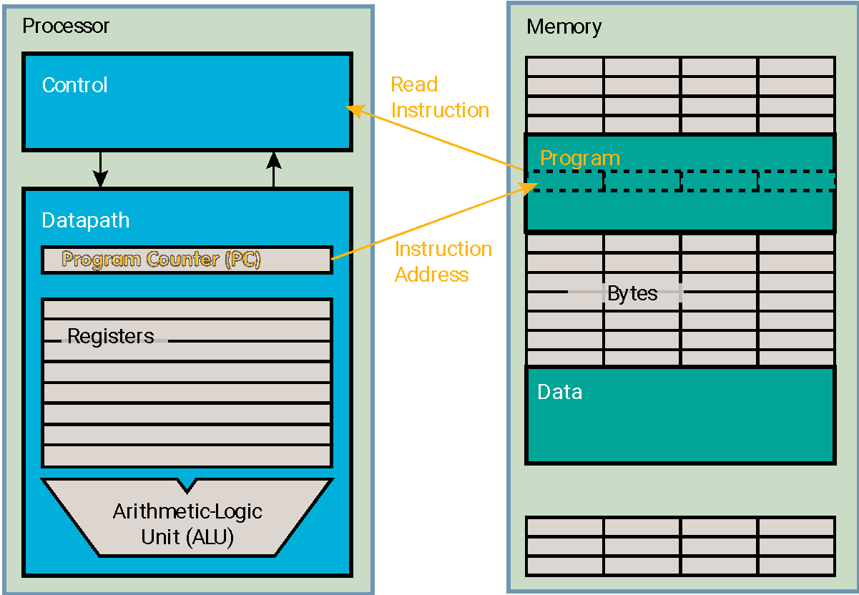
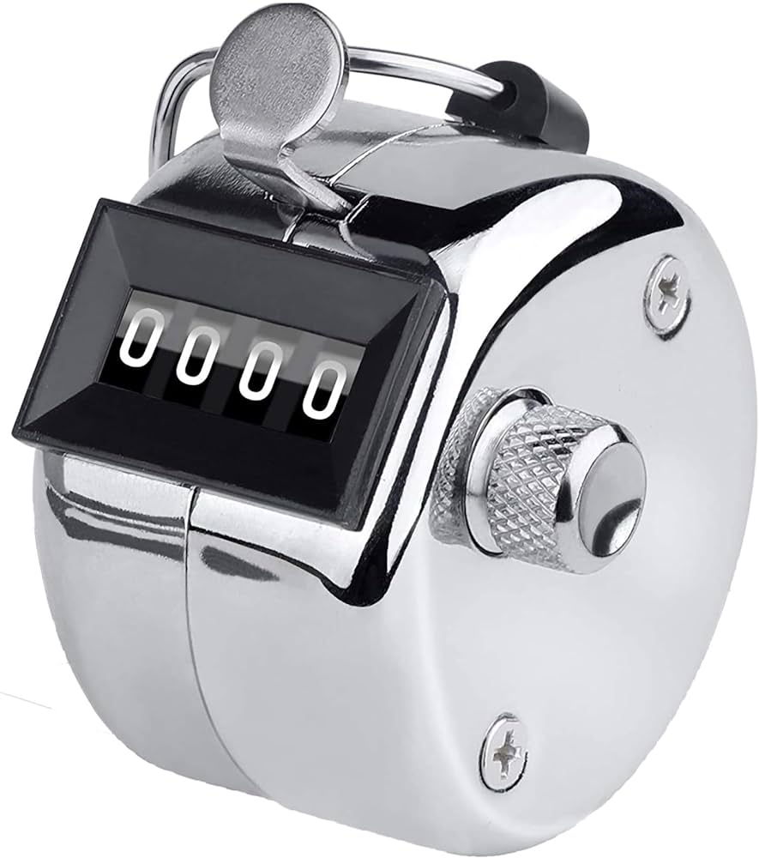
The Program Counter Register
RV32I Unprivileged ISA, 2.1:
There is one additional unprivileged register: the program counter pc holds the address of the current instruction.
Program execution:
Fetch instruction from memory using PC
Execute instruction
Update PC to next instruction
By default, the PC is updated to PC + 4 bytes (“next sequential instruction”) unless otherwise stated by the instruction itself.

Slide 18
Program Counter in action
0x0
0x4
0x8
0xc
0x10
…
… # li x10 0x34FF
slli x12 x10 0x10
srli x12 x12 0x08
and x12 x12 x10
0x0000 0008
pc
0x0000 0008
0x0000 000c
Program execution:
Fetch instruction from memory using PC
Execute instruction
Update PC to next instruction
x10
0x0000 34FF
x12
0xABCD ABCD
0xABCD ABCD
0x34FF 0000
By default, the PC is updated to PC + 4 bytes (“next sequential instruction”) unless otherwise stated by the instruction itself.

Slide 19
Conditional Branches

Slide 20
Control Flow in C
In C, run code one line at a time.
Usually the line immediately afterwards…
But control flow syntax creates structures that “jump” to other lines of code.
1
2
3
4
5
6
7
…
10
11
12
int foo(n) {
int a = 5;
if (n > 5) {
a += 1;
}
return a+n;
}
...
line;
foo(5);
line;
conditional jump
(otherwise)
C control flow structures:
If statements
If-else, if-else-elif, etc.
For loops
While loops
Function calls (more later)
unconditional jump
Control instructions in RISC-V adjust the program counter to conditionally/unconditionally jump to other instructions.

Slide 21
RISC-V Jumps
In RISC-V, a jump is a change in control flow.
The program counter is updated to NOT the next instruction as is the default (RV32I: current +4 bytes), but another instruction.
Unconditional jump instruction: j Label
Jump to the statement specified by the label Label
A pseudoinstruction (more next time)
Conditional jump, i.e., branch instruction
General format: bxx rs1 rs2 Label
Jumps to the specified Label only if the condition is met.
Otherwise (the condition is not met), just move to next line.

Slide 22
Branch if EQual, Branch if Not Equal
Branch if equal
beq rs1 rs2 Label
Branch if not equal
bne rs1 rs2 Label
if (R[rs1] == R[rs2])
PC = <address of Label>
Means:
Check if register values are equal: R[rs1]==R[rs2]
If true, then go to statement labeled Label
Otherwise, go to next statement (PC = PC + 4)
if (R[rs1] != R[rs2])
PC = <address of Label>
Means:
Check if register values are not equal: R[rs1]!=R[rs2]
If true, then go to statement labeled Label
Otherwise, go to next statement (PC = PC + 4)

Slide 23
Example 1: beq or bne?
Assume the following mapping of C variables ↔︎ registers:
x y z i j
x10 x11 x12 x13 x14
beq x13 x14 If
sub x10 x11 x12
j End
If: add x10 x11 x12
End: # …
A.
bne x13 x14 Else
add x10 x11 x12
j End
Else: sub x10 x11 x12
End: # …
B.
if (i == j) {
x = y + z;
} else {
x = y - z;
}
// …
Both valid!
…but B more closely reflects the original C structure, despite the negated branch condition.

Slide 24
Example 2: beq or bne?
Assume the following mapping of C variables ↔︎ registers:
x y z i j
x10 x11 x12 x13 x14
beq x13 x14 If
j End
If: add x10 x11 x12
End: # …
A.
bne x13 x14 End
add x10 x11 x12
End: # …
B.
if (i == j) {
x = y + z;
}
// …
Both valid! …but…
For readable, efficient RISC-V programs, you may need to negate the branch condition!

Slide 25
RISC-V Control Flow Operations
Instruction | Name/description
beq rs1 rs2 Label | Branch if EQual
bne rs1 rs2 Label | Branch if Not Equal
blt rs1 rs2 Label | Branch if Less Than (signed) (rs1 < rs2)
bge rs1 rs2 Label | Branch if Greater or Equal (signed) (rs1 >= rs2)
bltu rs1 rs2 Label | Branch if Less Than (unsigned)
bgeu rs1 rs2 Label | Branch if Greater Than or Equal (unsigned)
j Label | Unconditional jump
bgt, bgtu, ble, and bleu are not base RV32I instructions!
Pseudoinstructions
At home: Create these by reversing inputs of existing instructions.
🏡

Slide 26
Loops

Slide 27
Loops in C → Loops in Assembly
Several types of loops in C:
while
for
do-while
(CS 61A) Each can be rewritten as the other two.
In lecture: for loop → while loop → RISC-V code
In reference slides: while loop, do-while loop
Key points:
Once we learn how to write conditional branches with one loop, we can apply the same branching method to all loops.
Rethink C code using goto statements
⚠️ Don’t use goto in real C code! ⚠️ Only for RISC-V translation!

Slide 28
Exercise (1/9): Rewrite our C for loop
(original for loop)
int arr[20];
… // fill arr with data
int sum = 0;
for (int i=0; i<20; i++) {
sum += arr[i];
} // …
We suggest never writing C code with goto. However, understanding how to translate into goto helps to translate into assembly/RISC-V.
(rewrite with while loop)
int arr[20];
…
int sum = 0;
int i = 0;
while (i < 20) {
sum += arr[i];
i++;
} // …
(rewrite with goto)
int arr[20];
…
int sum = 0;
int i = 0;
Loop: if(i >= 20) goto End
sum += arr[i];
i++;
goto Loop
End: // …

Slide 29
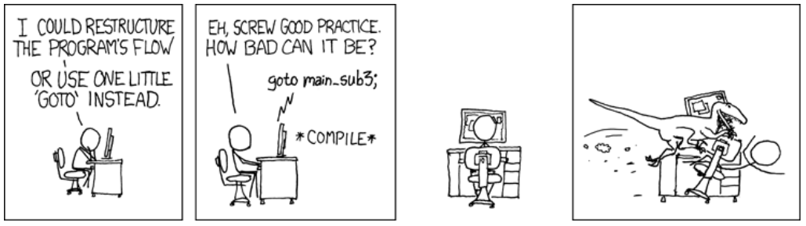
NEVER write your C code with goto
We suggest never writing C code with goto. However, understanding how to translate into goto helps to translate into assembly/RISC-V.
xkcd, explainxkcd

Slide 30
Exercise (2/9): RISC-V Code
int arr[20];
… // fill arr with data
int sum = 0;
for (int i=0; i<20; i++) {
sum += arr[i];
} // …
add x9 x8 x0
add x10 x0 x0
add x11 x0 x0
addi x13 x0 20
Loop: bge x11 x13 End
lw x12 0(x9)
add x10 x10 x12
addi x9 x9 4
addi x11 x11 1
j Loop
End: …
(rewrite with goto)
int arr[20];
…
int sum = 0;
int i = 0;
Loop: if(i >= 20) goto End
sum += arr[i];
i++;
goto Loop
End: // …

Slide 31
Exercise (3/9): Map C expressions to registers
int arr[20];
… // fill arr with data
int sum = 0;
for (int i=0; i<20; i++) {
sum += arr[i];
} // …
1. x8
2. x11
3. x9
4. x12
5. x10
6. x13
A. sum
B. i
C. 20
D. arr[0]
E. &arr[0]
F. arr[i]
G. &arr[i]
add x9 x8 x0
add x10 x0 x0
add x11 x0 x0
addi x13 x0 20
Loop: bge x11 x13 End
lw x12 0(x9)
add x10 x10 x12
addi x9 x9 4
addi x11 x11 1
j Loop
End: …
Suppose x8 has the address of arr. Map the remaining registers to C variables/expressions.

Slide 32
Exercise (4/9): Assume x8
x8: &arr[0]
int arr[20];
… // fill arr with data
int sum = 0;
for (int i=0; i<20; i++) {
sum += arr[i];
} // …
1. x8
2. x11
3. x9
4. x12
5. x10
6. x13
A. sum
B. i
C. 20
D. arr[0]
E. &arr[0]
F. arr[i]
G. &arr[i]
add x9 x8 x0
add x10 x0 x0
add x11 x0 x0
addi x13 x0 20
Loop: bge x11 x13 End
lw x12 0(x9)
add x10 x10 x12
addi x9 x9 4
addi x11 x11 1
j Loop
End: …
x9
x10
x11
x12
x13

Slide 33
Exercise (5/9): x11
x8: &arr[0]
int arr[20];
… // fill arr with data
int sum = 0;
for (int i=0; i<20; i++) {
sum += arr[i];
} // …
1. x8
2. x11
3. x9
4. x12
5. x10
6. x13
A. sum
B. i
C. 20
D. arr[0]
E. &arr[0]
F. arr[i]
G. &arr[i]
B. i
add x9 x8 x0
add x10 x0 x0
add x11 x0 x0
addi x13 x0 20
Loop: bge x11 x13 End
lw x12 0(x9)
add x10 x10 x12
addi x9 x9 4
addi x11 x11 1
j Loop
End: …
# i=0
# i++
x9
x10
x11
<i>
x12
x13

Slide 34
Exercise (6/9): x9
x8: &arr[0]
int arr[20];
… // fill arr with data
int sum = 0;
for (int i=0; i<20; i++) {
sum += arr[i];
} // …
1. x8
2. x11
3. x9
4. x12
5. x10
6. x13
A. sum
B. i
C. 20
D. arr[0]
E. &arr[0]
F. arr[i]
G. &arr[i]
add x9 x8 x0
add x10 x0 x0
add x11 x0 x0 # i=0
addi x13 x0 20
Loop: bge x11 x13 End
lw x12 0(x9)
add x10 x10 x12
addi x9 x9 4
addi x11 x11 1 # i++
j Loop
End: …
G. &arr[i]
# &arr[0]
# &arr[i+1]
x9
<&arr[i]>
x10
x11
<i>
x12
x13

Slide 35
Exercise (7/9): x10, x12
x8: &arr[0]
1. x8
2. x11
3. x9
4. x12
5. x10
6. x13
A. sum
int arr[20];
… // fill arr with data
int sum = 0;
for (int i=0; i<20; i++) {
sum += arr[i];
} // …
A. sum
B. i
C. 20
D. arr[0]
E. &arr[0]
F. arr[i]
G. &arr[i]
F. arr[i]
add x9 x8 x0 # &arr[0]
add x10 x0 x0
add x11 x0 x0 # i=0
addi x13 x0 20
Loop: bge x11 x13 End
lw x12 0(x9)
add x10 x10 x12
addi x9 x9 4 # &arr[i+1]
addi x11 x11 1 # i++
j Loop
End: …
# sum = 0
# sum+=arr[i]
x9
<&arr[i]>
x10
<sum>
x11
<i>
x12
<arr[i]>
x13

Slide 36
Exercise (8/9): x13
x8: &arr[0]
int arr[20];
… // fill arr with data
int sum = 0;
for (int i=0; i<20; i++) {
sum += arr[i];
} // …
6. x13
C. 20
bge compares two registers; the immediate 20 must therefore be in register x13
bge exits loop if true.
Otherwise if false, then i < 20; continue in loop
add x9 x8 x0 # &arr[0]
add x10 x0 x0 # sum = 0
add x11 x0 x0 # i=0
addi x13 x0 20
Loop: bge x11 x13 End
lw x12 0(x9)
add x10 x10 x12 # sum+=arr[i]
addi x9 x9 4 # &arr[i+1]
addi x11 x11 1 # i++
j Loop
End: …
x9
<&arr[i]>
# i >= 20 → jump
x10
<sum>
x11
<i>
x12
<arr[i]>
x13
20

Slide 37
Exercise (9/9): Full Code
x8: &arr[0]
int arr[20];
… // fill arr with data
int sum = 0;
for (int i=0; i<20; i++) {
sum += arr[i];
} // …
bge compares two registers; the immediate 20 must therefore be in register x13
bge exits loop if true.
Otherwise if false, then i < 20; continue in loop
add x9 x8 x0 # &arr[0]
add x10 x0 x0 # sum = 0
add x11 x0 x0 # i=0
addi x13 x0 20
Loop: bge x11 x13 End # i >= 20 → jump
lw x12 0(x9)
add x10 x10 x12 # sum+=arr[i]
addi x9 x9 4 # &arr[i+1]
addi x11 x11 1 # i++
j Loop
End: …
x9
<&arr[i]>
x10
<sum>
x11
<i>
x12
<arr[i]>
x13
20

Slide 38
[Summary] RISC-V So Far
Arithmetic
add
sub
and
or
xor
sll
srl
sra
Immediate
addi
andi
ori
xori
slli
srli
srai
li (pseudo)
Loads/Stores
lw
lb
lbu
sw
sb
Branches/ Jumps
beq
bne
bge
blt
bgeu
bltu
j (pseudo)

Slide 39
[Extra] Long Example

Slide 40
Long Example (1/5): C code
int a = 0;
for(int i = 0; i < 10; i++) {
if(i == 7) {
break;
}
a = a + i;
}
a = a + 50;

Slide 41
Long Example (2/5): C code: break → goto
int a = 0;
for(int i = 0; i < 10; i++) {
if(i == 7) goto End;
a = a + i;
}
End: a = a + 50;

Slide 42
Long Example (3/5): C code: loop → goto
int a = 0;
int i = 0;
Loop: if(i >= 10) goto End;
if(i == 7) goto End;
a = a + i;
i = i + 1;
goto Loop;
End: a = a + 50;

Slide 43
Long Example (4/5): C code: Small trick (why?)
int a = 0;
int i = 0;
Loop:
int j = 10;
if(i >= j) goto End;
j = 7;
if(i == j) goto End;
a = a + i;
i = i + 1;
goto Loop;
End: a = a + 50;

Slide 44
Long Example (5/5): RISC-V code
li x10 0 #int a = 0;
li x5 0 #int i = 0;
Loop:
li x6 10 #int j = 10;
bge x5 x6 End #if(i >= j) goto End;
li x6 7 #j = 7;
beq x5 x6 End #if(i == j) goto End;
add x10 x10 x5 #a = a + i;
addi x5 x5 1 #i = i + 1;
j Loop #goto Loop;
End: addi x10 x10 50 #a = a + 50;

Slide 45
[Reference] More C goto

Slide 46
New C operator: goto and Labels
A label is an identifier to a particular line of code
Doesn't count as a line of code itself; merely "points out" a particular line
Each label must have a unique name (like variable names)
The goto statement changes the next line to be run to the labelled line
The label can be either before or after the goto statement.
Target: line; line; line; goto Target; line;
Next Line
Current Line

Slide 47
goto Example: Handling Mallocs
int* a = malloc(sizeof(int)*1000);
int* b = malloc(sizeof(int)*1000000);
int* c = malloc(sizeof(int)*1000000000);
FILE* d = fopen(filename);

Slide 48
goto Example: Handling Mallocs
int* a = malloc(sizeof(int)*1000);
int* b = malloc(sizeof(int)*1000000);
int* c = malloc(sizeof(int)*1000000000);
FILE* d = fopen(filename);
Bad code: malloc can fail (returning NULL), and we should catch that before it causes a segfault

Slide 49
goto Example: Handling Mallocs
int* a = malloc(sizeof(int)*1000);
if(a == NULL) allocation_failed();
int* b = malloc(sizeof(int)*1000000);
if(b == NULL) allocation_failed();
int* c = malloc(sizeof(int)*1000000000);
if(c == NULL) allocation_failed();
FILE* d = fopen(filename);
if(d == NULL) allocation_failed();

Slide 50
goto Example: Handling Mallocs
int* a = malloc(sizeof(int)*1000);
if(a == NULL) allocation_failed();
int* b = malloc(sizeof(int)*1000000);
if(b == NULL) allocation_failed();
int* c = malloc(sizeof(int)*1000000000);
if(c == NULL) allocation_failed();
FILE* d = fopen(filename);
if(d == NULL) allocation_failed();
Bad code: leaks memory since a gets allocated but never freed.

Slide 51
goto Example: Handling Mallocs
int* a = malloc(sizeof(int)*1000);
if(a == NULL) allocation_failed();
int* b = malloc(sizeof(int)*1000000);
if(b == NULL) {
free(a);
allocation_failed();
}
int* c = malloc(sizeof(int)*1000000000);
if(c == NULL) {
free(b);
free(a);
allocation_failed();
}
FILE* d = fopen(filename);
if(d == NULL) {
free(c);
free(b);
free(a);
allocation_failed();
}

Slide 52
goto Example: Handling Mallocs
int* a = malloc(sizeof(int)*1000);
if(a == NULL) goto ErrorA;
int* b = malloc(sizeof(int)*1000000);
if(b == NULL) goto ErrorB;
int* c = malloc(sizeof(int)*1000000000);
if(c == NULL) goto ErrorC;
FILE* d = fopen(filename);
if(d == NULL) {
free(c);
ErrorC: free(b);
ErrorB: free(a);
ErrorA: allocation_failed();
}

Slide 53
Reducing C with goto: Break
while(true) { line; break; } line;
while(true) { line; goto AfterWhile; } AfterWhile:
line;

Slide 54
Reducing C with goto: If without an Else
if(cond) {
line1;
line2;
}
line3;
if(!cond) goto AfterIf;
line1;
line2;
AfterIf:
line3;

Slide 55
Reducing C with goto: Do-While
do {
line1;
line2;
} while(cond)
line3;
Loop:
line1;
line2;
if(cond) goto Loop;
line3;

Slide 56
Reducing C with goto: While
while(cond) {
line1;
line2;
}
line3;
Loop:
if(!cond) goto AfterLoop;
line1;
line2;
goto Loop;
AfterLoop:
line3;

Slide 57
Reducing C with goto: For
for(startline;cond;incline) {
line1;
line2;
}
line3;
startline;
Loop:
if(!cond) goto AfterLoop
line1;
line2;
incline;
goto Loop
AfterLoop:
line3;
startline;
while(cond) {
line1;
line2;
incline;
}
line3;

